Slide 1
Customer Churn Analysis – ABC Communications Ltd
Week 1 Business Analytics Case Study
AnalystLab Africa
Juliet Chiejina
August 2026

Slide 2
Agenda
Business Understanding
Dataset Overview
Key Findings
Insights, Risks & Opportunities
Recommendations
Conclusion

Slide 3
Business Understanding
Client: ABC Communications Ltd
Problem: High customer churn
Goal: Understand why customers leave and recommend actions

Slide 4
Dataset Overview
7,043 customers
21 features
Clean data (no missing values or duplicates)
Target variable: Churn (Yes/No)

Slide 5
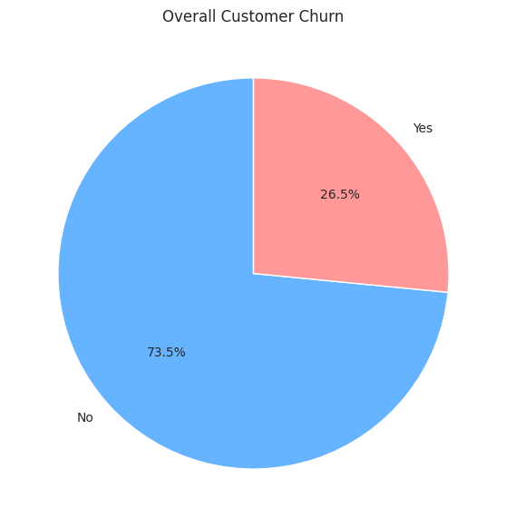
26.5% churned

Slide 6
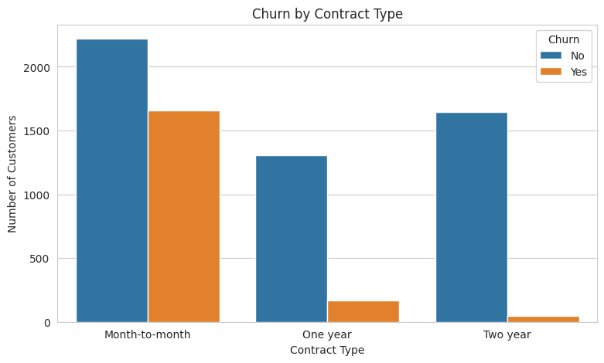
Month-to-month has the highest churn

Slide 7
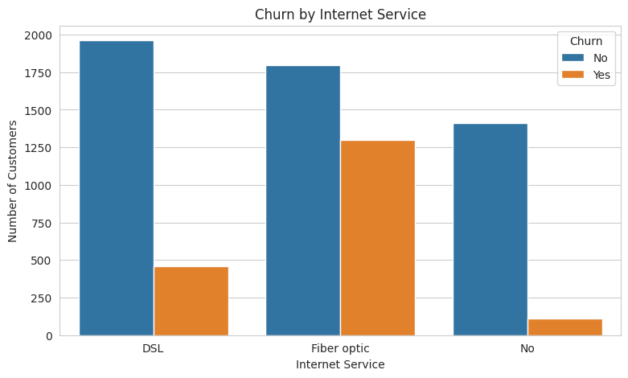
Fiber optic customers churn the most

Slide 8
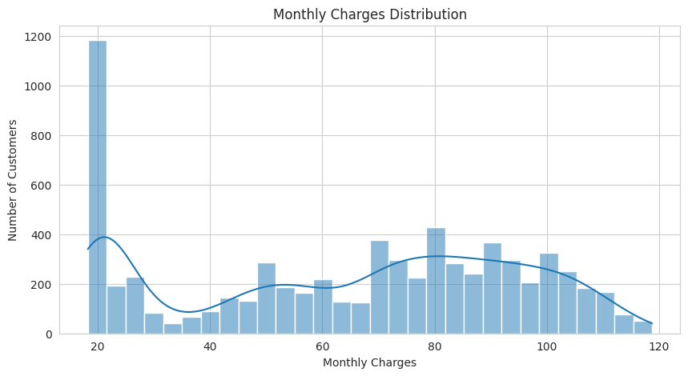

Slide 9
Key Insights
Overall churn rate is about 26.5%.
Month-to-month contract customers have the highest churn.
Fiber optic internet service customers churn more than others.
Customers who leave tend to have short tenure.
Customers who churn usually have higher monthly charges.

Slide 10
Business Risks
Opportunities
Heavy reliance on month-to-month contracts creates unstable revenue.
High churn among Fiber optic users may indicate service problems.
Early customer departure means the company loses money
Convert more customers to longer-term contracts.
Improve Fiber optic service quality and value.
Create targeted retention programmes for new customers

Slide 11
Recommendations
Offer incentives for customers to move from month-to-month to 1-year or 2-year contracts.
Investigate and improve Fiber optic service quality and pricing.
Launch a special retention programme for customers in their first 6–12 months.
Review pricing packages for customers with high monthly charges.
Introduce a “Loyalty Checkpoint” at Month 3 and Month 6 and automatically contact new customers at these critical points with a small benefit (extra data, discount, or free service upgrade) before they decide to leave

Slide 12
Conclusion
Customer churn is driven mainly by contract type, tenure, internet service, and monthly charges
Clear actions can reduce churn and improve retention

Slide 13
Thank you

